Slide 1
Green Jobs
3-4 March 2021
Anubhav Mittal
Katie Dickerson
Lorna Hayton

Slide 2
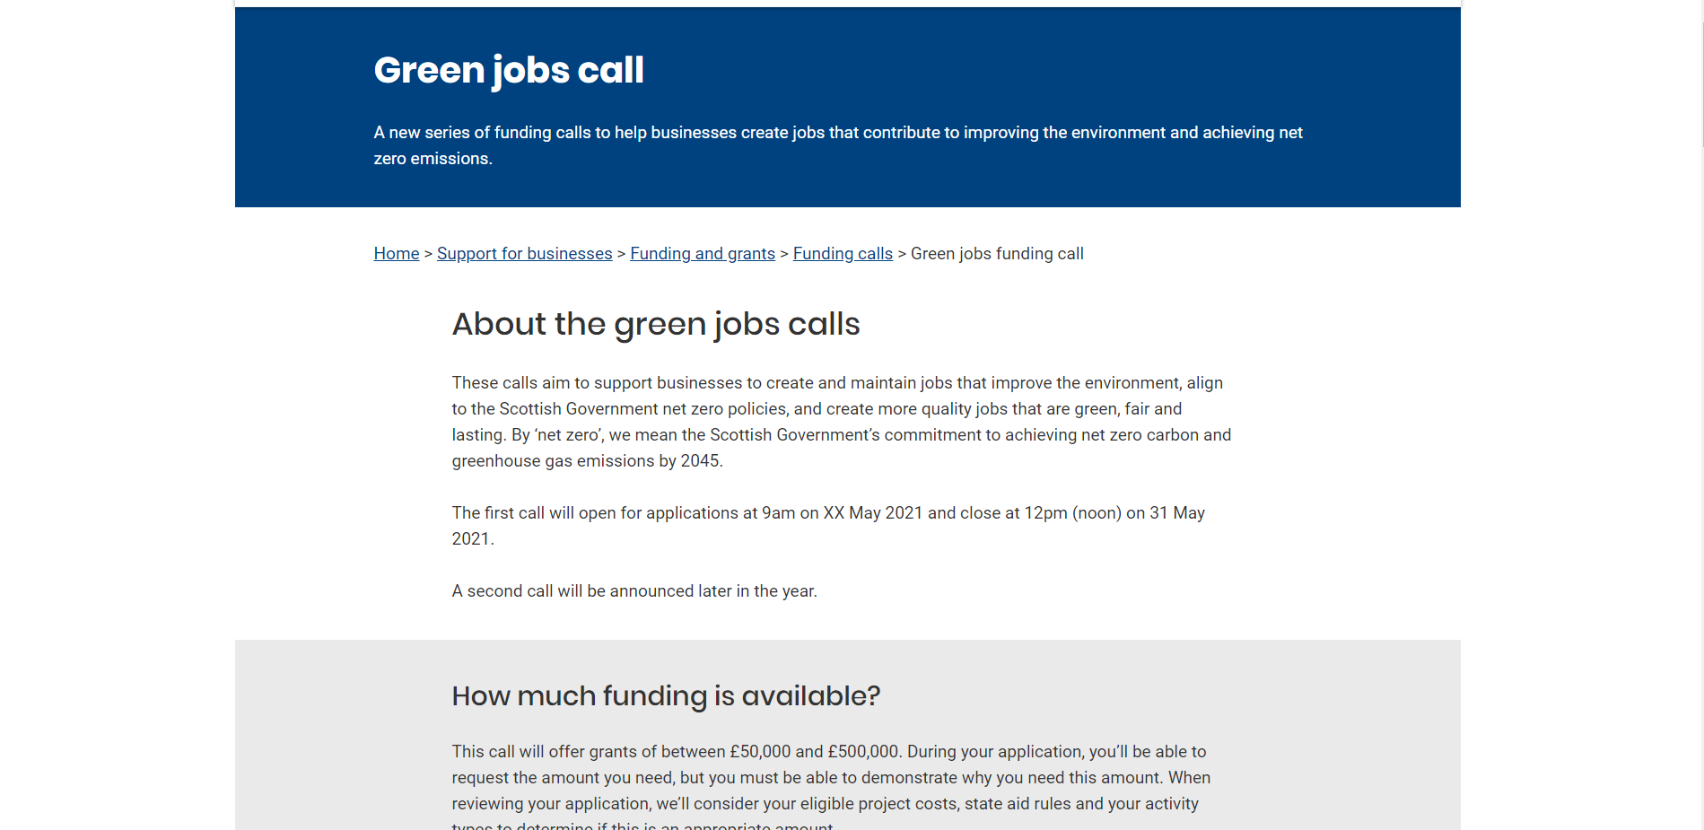
What we tested
We showed users the Green Jobs prototype

Slide 3
Who we tested with
6 business owners
3 men, 3 women
Using video calls (Microsoft Teams)

Slide 4
What we were trying to find out
Do users understand what the different types of evidence are and what they would provide? Is it clear who’s eligible for the call?
Is it clear what kind of projects the call could support?
Is the claims content useful and would users want to know more before applying?
Did users find it useful to know what factors we’ll consider when reviewing applications?
Is there anything that’s unclear or missing? Anything users would have liked to know more about?
Is the language clear/do we use any unfamiliar terms?
Did you notice the postcode checker? If so, was it clear why this was provided?

Slide 5
Results summary
Language is clear
The page is too content-heavy – users struggle to take in all of the information
The information about claims needs to be higher up on the page
Users need more clarity about what a green job is – some examples would be helpful
The postcode checker is clear, but we need to ensure it's clear what to do if you aren't in the Scottish Enterprise area

Slide 6
Recommendations
Investigate using accordions to make the content on the page easier to digest
Move the claims section higher up the page
Add some examples of what a green job is
Link off to similar services in the HIE/SoSE areas so businesses in those areas don't hit a dead end

Slide 7
Comments on the content
Positive
"Even someone who has never done an application would find this easy to follow.”
"I feel that every time I think of a question it's answering it."
“My initial thought is that there is a lot of information on the front page, but it seems its all important stuff to help you decide whether to go ahead with an application."
Negative
“You’ve got too much text - I had to scroll way too much there.”
"Does it need to be so copy-heavy or could it be communicated in a more digestible way?"
"I skimmed a lot because it was so text based."

Slide 8
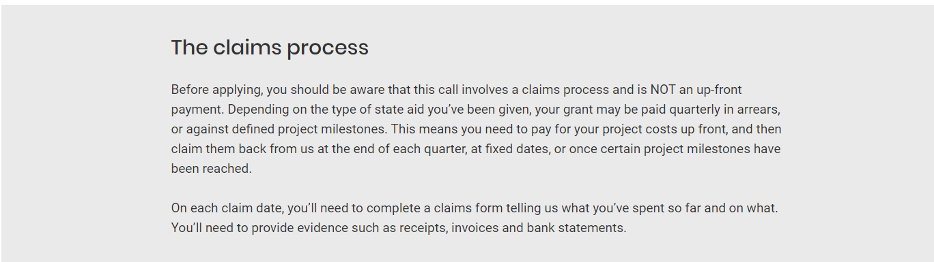
The claims process
Most people didn't notice this section without prompting
The claims process may eliminate businesses so it should be more obvious or up higher
One user suggested that you should have to click a disclaimer saying that you have read the claims process before applying

Slide 9
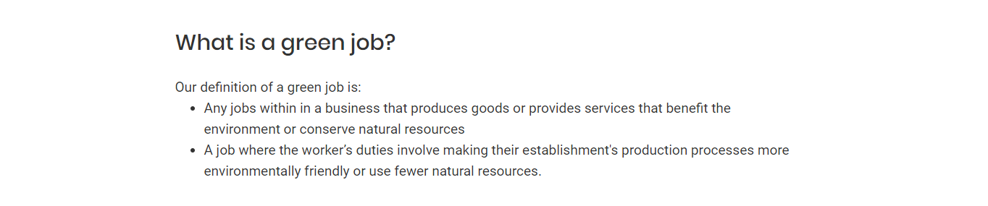
What is a green job?
Users would like to see more information about what a green job is with some examples
"Maybe examples from different sectors to make it more tangible"
"It doesn't say what it means to be green-focused."

Slide 10
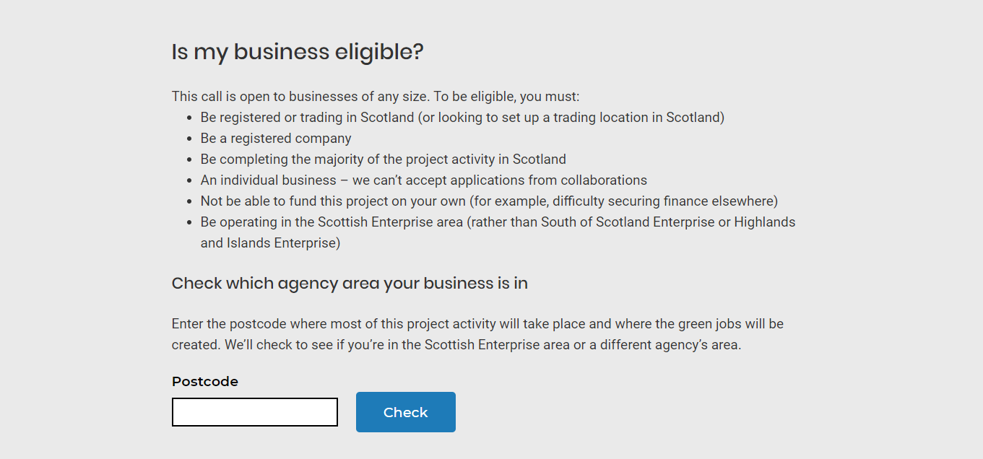
The postcode checker
Move the last bullet point after the first one, so people who are outside the SE area can find out that they're ineligible as soon as possible
Ensure that users who are in the HIE and SoSE areas are directed to similar services they could apply for

Slide 11
Fin

